Slide 1
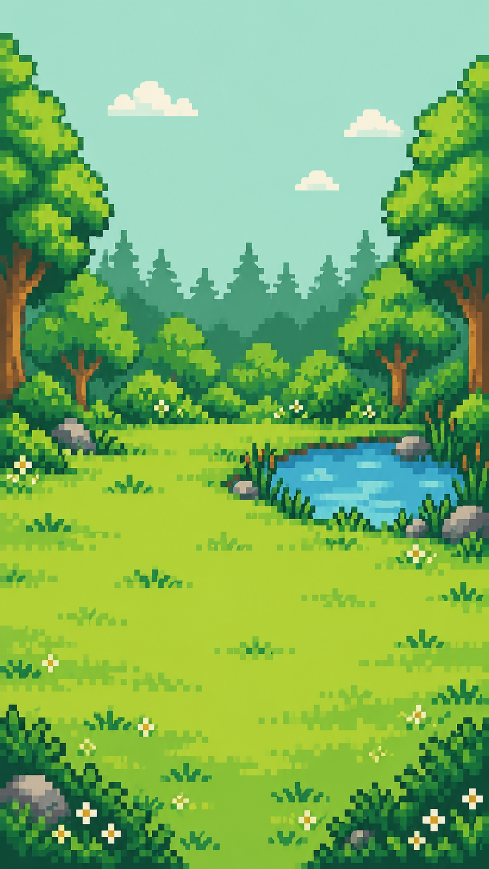

CodeRED: Orion
Best Environment Hack
EcoGotchi
A pocket habitat that grows
with your recycling habits.
Farden Khan
Jintian Wu
Colin Bond-Burt
Christopher Wiratman
Notes:
EcoGotchi is our native iPhone habitat game for the Best Environment Hack track at CodeRED: Orion. Players care for pixel pets and restore a virtual environment through a guided recycling activity. Introduce the team. The demo is a gameplay prototype, not a validated measure of environmental impact.
App source: /Users/jinhua/Documents/Github Internal/Github/CodeRed_Orion/README.md. Implemented behavior also checked against EcoGotchi/Models/HabitatState.swift, HabitatStore.swift, and EcoGotchiApp.swift. Artwork: original bundled EcoGotchi assets, generated for this project. Team names and event context retained from the supplied Recycli presentation.

Slide 2
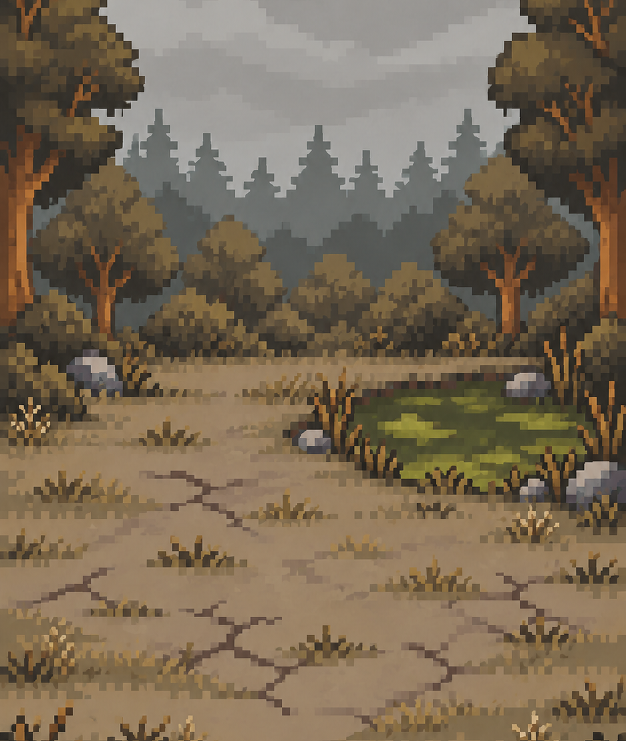
The recycling habit
Our goal is to make recycling
easier to repeat.
A place to start
Nearby recycling locations help people
find where to take their items.
A reason to return
A recovering habitat makes progress
visible and gives pets a home.
POLLUTED
Litter changes the habitat.
Notes:
The project tackles the everyday habit of recycling. The location finder helps users discover a destination, while the virtual habitat creates a reason to return. This is a design hypothesis to test, not a measured claim of behavior change. In the game, litter accumulates over time and changes the scenery. At low habitat health, pets shelter without disappearing from the player’s collection. Habitat condition and rewards are game mechanics rather than environmental impact estimates.
App source: /Users/jinhua/Documents/Github Internal/Github/CodeRed_Orion/README.md. Implemented behavior also checked against EcoGotchi/Models/HabitatState.swift, HabitatStore.swift, and EcoGotchiApp.swift. Artwork: original bundled EcoGotchi assets, generated for this project. Team names and event context retained from the supplied Recycli presentation.

Slide 3
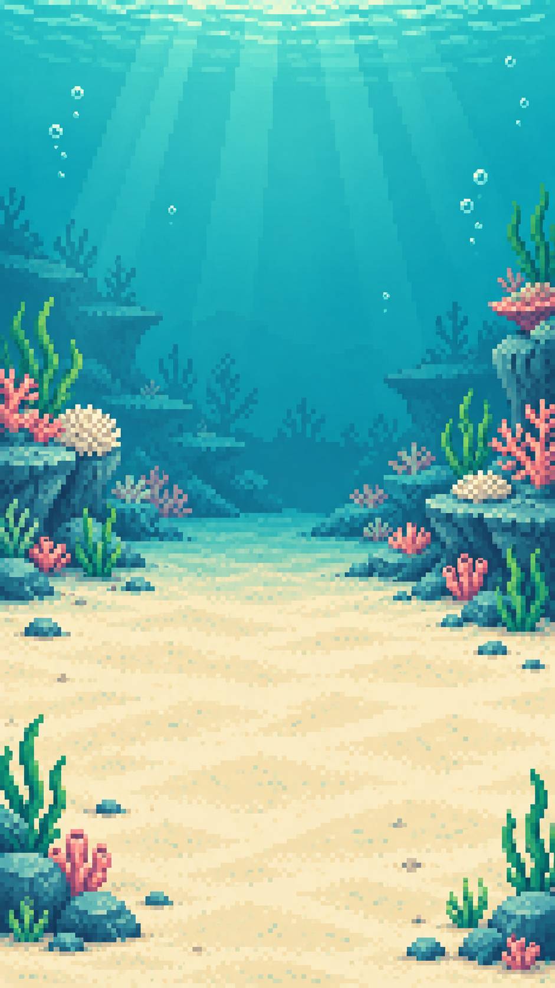

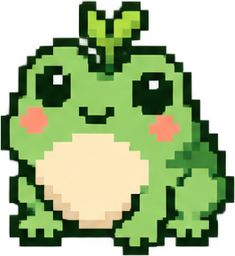

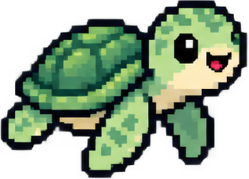
Three living habitats
Willow Grove
Coral Cove
Snow Glade
Leaves and pond ripples
Bubbles and swaying kelp
Snowfall and ice sparkles
12 pets. Four conditions. Separate habitat progress.
Notes:
Switch freely among Willow Grove, Coral Cove, and Snow Glade. Each world has four pets and keeps its own litter, action milestones, and condition, while all share the leaf wallet. Conditions are Thriving, Littered, Tarnished, and Polluted. The forest has drifting leaves and pond ripples, the reef has bubbles and kelp, and the snow habitat has snow and ice effects. Players start with one local pet and unlock others after 1, 3, and 6 actions in that habitat. The slide shows existing app artwork, not screenshots of the animation in motion.
App source: /Users/jinhua/Documents/Github Internal/Github/CodeRed_Orion/README.md. Implemented behavior also checked against EcoGotchi/Models/HabitatState.swift, HabitatStore.swift, and EcoGotchiApp.swift. Artwork: original bundled EcoGotchi assets, generated for this project. Team names and event context retained from the supplied Recycli presentation.

Slide 4

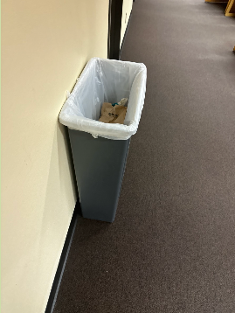
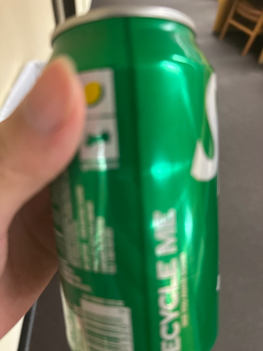
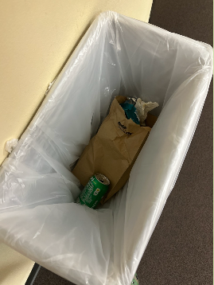
The recycling loop
Three photos in one camera session
01 Bin
02 Item
03 Disposal
20 leaves
1 piece of virtual
litter cleared
Demo mode accepts the captures automatically.
Optional AI review checks visible evidence.
Notes:
For the live demo, tap Recycle and capture the bin, item, and disposal in the same session. Each photo triggers a scan animation, a success message, haptics, and an original retro chime. After the third capture, default demo mode automatically awards 20 leaves and clears one piece of virtual litter. It does not classify the images or verify correct recycling. The photos here are example captures from the user-supplied review screenshot, not evidence of an approved recycling action. In particular, the unmarked bin is not established as a recycling bin. Optional AI review is a separate mode and can reject or mark evidence unclear. Image source: user attachment codex-clipboard-3d2131c4-3723-43de-a405-9b908c8b6715.png.
App source: /Users/jinhua/Documents/Github Internal/Github/CodeRed_Orion/README.md. Implemented behavior also checked against EcoGotchi/Models/HabitatState.swift, HabitatStore.swift, and EcoGotchiApp.swift. Artwork: original bundled EcoGotchi assets, generated for this project. Team names and event context retained from the supplied Recycli presentation.

Slide 5
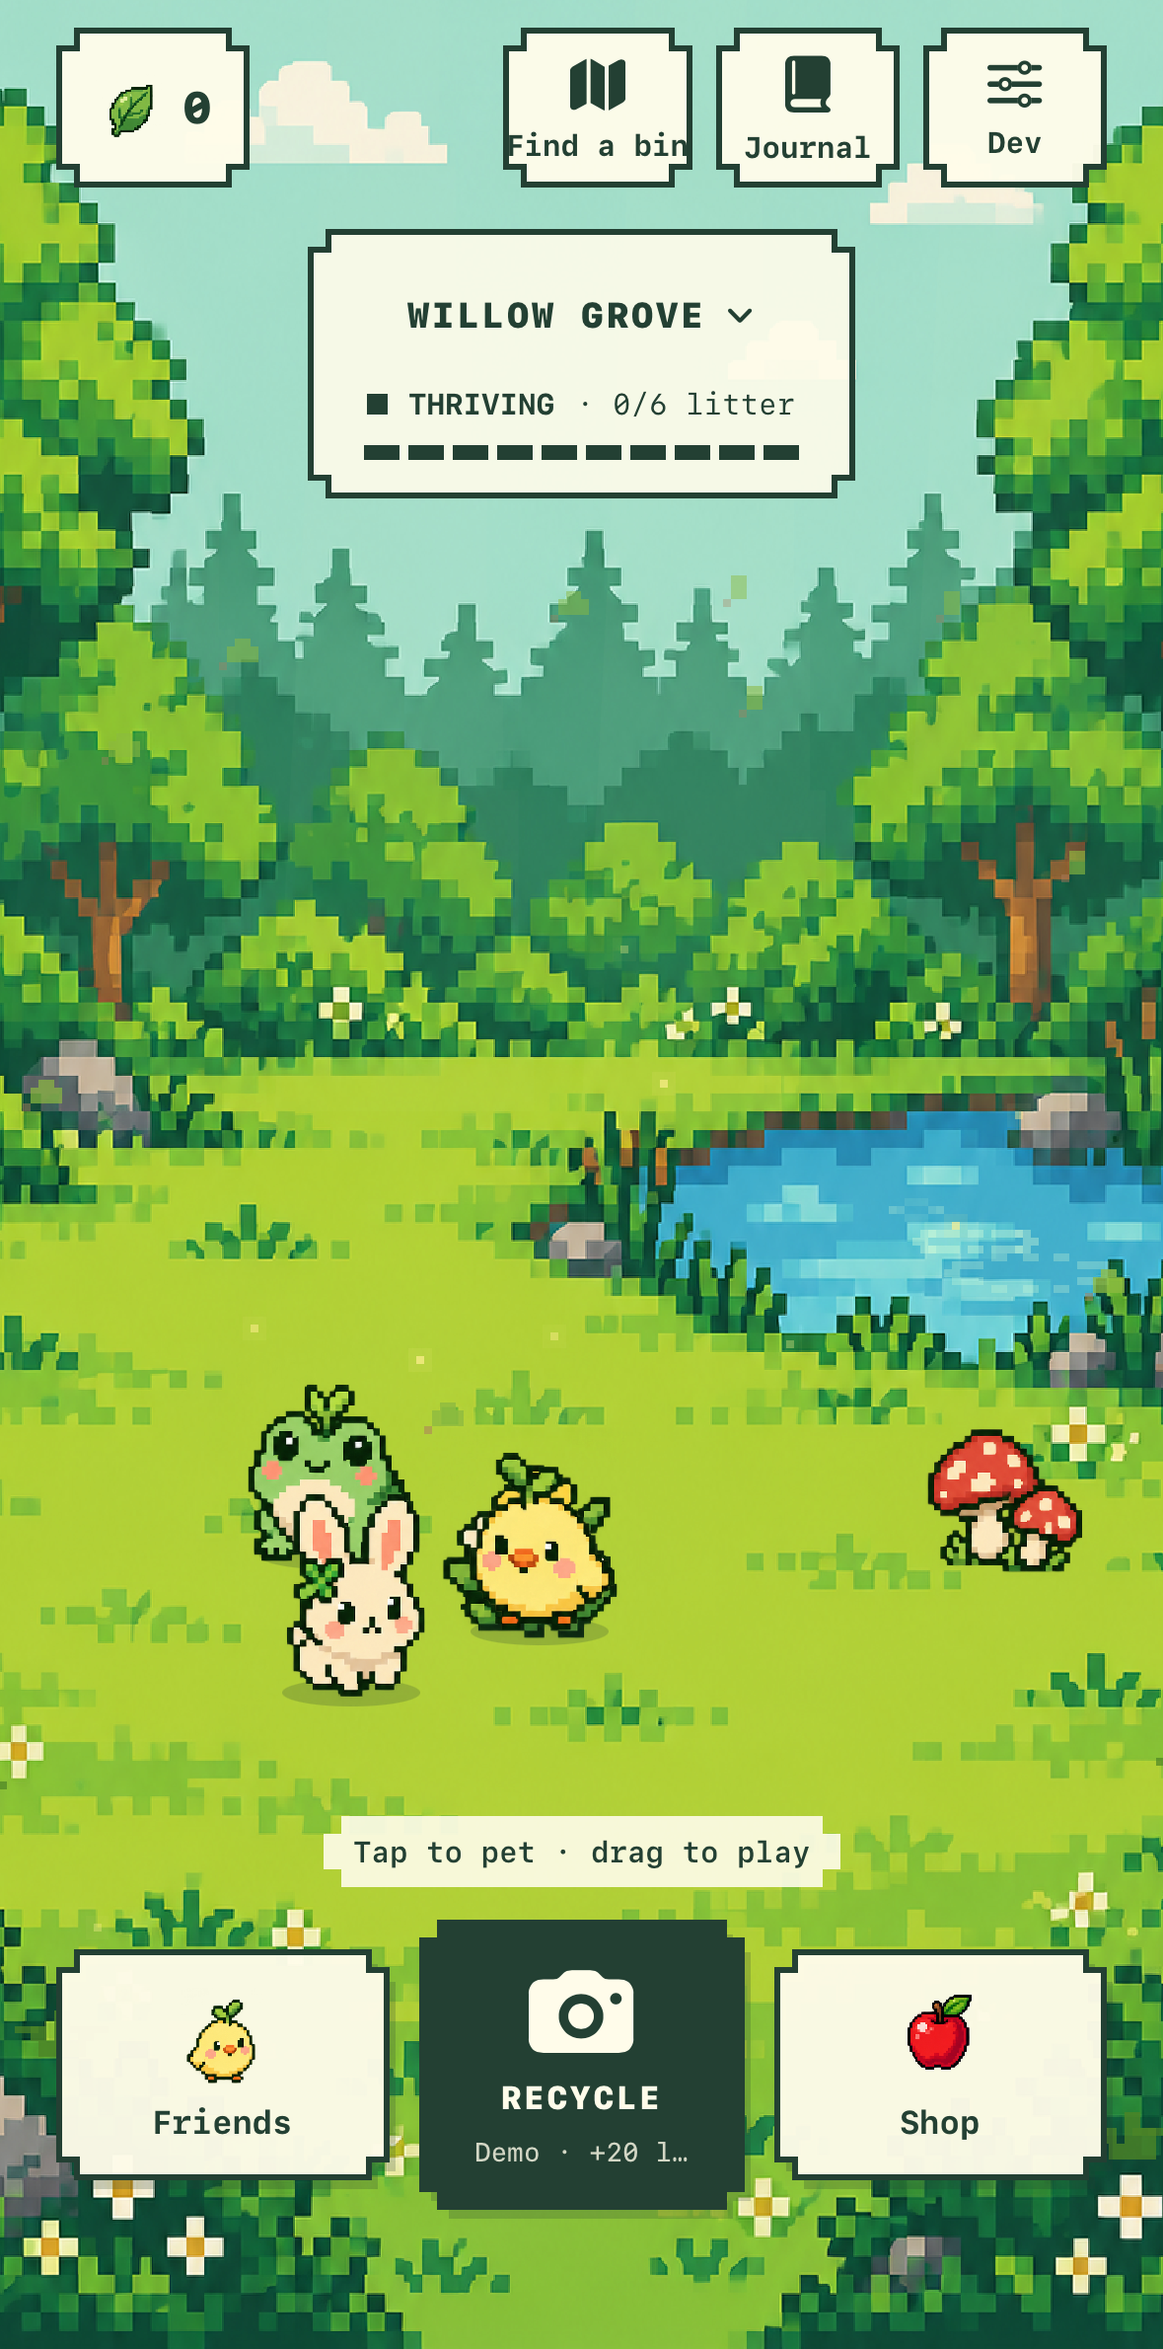
A habitat worth
returning to
Pets that respond
Tap to pet. Drag, toss, and feed
your pixel friends.
Your own arrangement
Buy decorations with leaves,
then move and lock them.
Help beyond the habitat
Find nearby recycling locations
and open directions in Apple Maps.
iPhone prototype
Notes:
Show the running app. Tap a pet for a reaction, pick it up and release it, then feed it from the Shop. Decorations can be dragged and locked, and the arrangement persists. The Find a bin feature uses current location only after the user asks, or a typed city/ZIP code, and opens directions in Apple Maps. Coverage and listed materials vary. Checking a map location does not award leaves or prove correct disposal. Image source: user attachment codex-clipboard-b50f9846-6b0a-4868-b374-b485eaac1bb1.png, cropped only to remove the unrelated iOS status area.
App source: /Users/jinhua/Documents/Github Internal/Github/CodeRed_Orion/README.md. Implemented behavior also checked against EcoGotchi/Models/HabitatState.swift, HabitatStore.swift, and EcoGotchiApp.swift. Artwork: original bundled EcoGotchi assets, generated for this project. Team names and event context retained from the supplied Recycli presentation.

Slide 6
Built for iPhone
SwiftUI + AVFoundation
Local progress
Native habitat, camera capture,
sound, and haptics.
Pets, leaves, journal, and layouts
persist on the device.
MapKit + public data
Optional Gemini review
OpenStreetMap recycling points,
plus Houston city facilities.
A Node.js server sends three
photos in one request.
Demo scanning works offline. It does not verify disposal.
AI can assess photos, but cannot prove that recycling happened.
Notes:
The working client is native Swift and SwiftUI, not React Native. Camera capture uses AVFoundation. Game state persists locally in UserDefaults. The optional review service uses Node.js and Google Gemini and keeps the API key on the server. Default demo mode needs no server and uploads no photos. AI mode submits the three selected images together, not a continuous video stream. Only approved AI reviews grant material-based rewards, while unclear or rejected reviews grant zero. The game has no implemented Firebase login, TensorFlow Lite classifier, or community leaderboard. Developer mode can preview habitat conditions and features without overwriting the saved game.
Map sources used by the app: https://wiki.openstreetmap.org/wiki/Overpass_API and https://services2.arcgis.com/LYMgRMwHfrWWEg3s/ArcGIS/rest/services/City_of_Houston_SWMD_Recycling_Disposal_Facilities/FeatureServer.
App source: /Users/jinhua/Documents/Github Internal/Github/CodeRed_Orion/README.md. Implemented behavior also checked against EcoGotchi/Models/HabitatState.swift, HabitatStore.swift, and EcoGotchiApp.swift. Artwork: original bundled EcoGotchi assets, generated for this project. Team names and event context retained from the supplied Recycli presentation.

Slide 7

What comes next
Campus pilot
Test repeat use and learn where
recycling guidance is unclear.
Stronger verification
Improve local sorting rules and
explore partnerships with smart bins.
Conservation support
Explore paid cosmetics that fund
real habitat projects.
Future plans. Payments and donations are not live.
Notes:
The next step is a small campus pilot to test whether people return and whether the guidance helps. More reliable sorting guidance and bin partnerships would be needed before using rewards as a signal of verified disposal. Paid cosmetics supporting real habitat projects are a future concept. No payments or donation integration exists today. Environmental impact would need measurement with pilot partners. Close by returning to the live app and inviting the judges to interact with a pet.
App source: /Users/jinhua/Documents/Github Internal/Github/CodeRed_Orion/README.md. Implemented behavior also checked against EcoGotchi/Models/HabitatState.swift, HabitatStore.swift, and EcoGotchiApp.swift. Artwork: original bundled EcoGotchi assets, generated for this project. Team names and event context retained from the supplied Recycli presentation.

